Slide 1
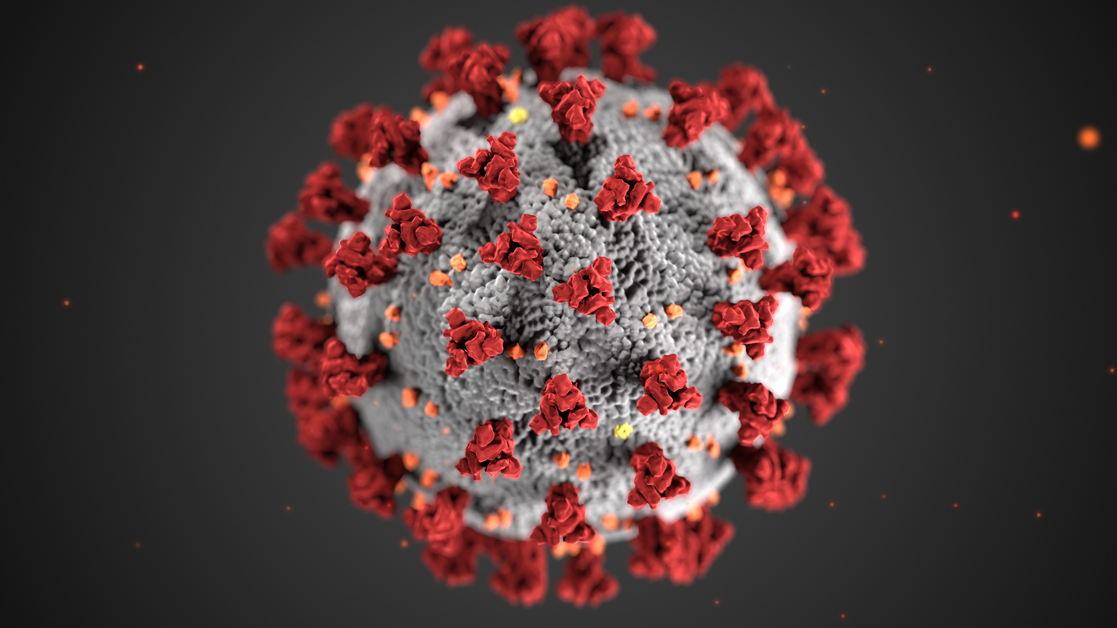
COVID-19 Updates: Vaccine Information
Gregory Gahm, MD
1/5/20

Slide 2
2 Types of vaccine
Traditional
Virus is grown, killed, and obliterated mechanically (RNA is discarded)
Spike proteins from this dead virus (orange in the photo) are collected and added to saline to make the vaccine
Messenger RNA (mRNA: Moderna & Pfizer)
DO NOT contain a live virus and DO NOT carry a risk of causing disease
Strands of messenger RNA are placed in a lipid coating that prevents it from the body’s enzymes and help it enter muscle cells at the injection site
Once in the cell, it goes to ribosomes, directing them to make spike proteins
These spike proteins migrate to the cell surface where this antigen stimulates antibodies and activating T-Cells specific to SARS-CoV-2

Slide 3
Messenger RNA Vaccines
Requires 2 doses given about a month apart
Immunity peaks / is reached about 1 week after the second dose
Because it only leads to Spike Proteins from the virus’ surface…
THE VACCINE CANNOT CAUSE COVID-19

Slide 4
Fda requirements for vaccines
Efficacy
FDA requires the vaccine to have >50% efficacy
Pfizer / Moderna efficacy is being measured by the number of vaccinated vs. control participants who get symptomatic Covid starting 1 week after second dose is given
Safety
Almost all adverse effects (for all vaccines) happen in the first 6 weeks after vaccination
8 weeks of safety data must be reported on >3000 participants
Vaccine safety concerns for ALL vaccines are tracked through VAERS [Vaccine Adverse Event Reporting System], a national database of potential side effects that is continuously monitored and investigated
13 Current Phase 3 trials underway with >500,000 participants

Slide 5
Mrna Vaccine efficacy
67,000 Participants* | Placebo Group | Vaccine Group
Persons who got Covid | 347 | 19
Those who got severe Covid, leading to hospitalization and/or death | 39 (1 death) | 1
Interpretation: the chances of getting Covid are about 20 times higher without getting the vaccine, while the risk of having a severe, life-threatening case was almost 40 times higher!
*As of 12/5/20

Slide 6
Who evaluates vaccines?
2 advisory committees:
Vaccine & Related Biological Products Advisory Committee (VRBPAC) advises FDA
Advisory Committee on Immunization Practices (ACIP) advises the CDC
Both are independent, monitoring vaccines to ensure safety
Experts from academic institutions who are vetted to avoid conflicts of interest
Advise on vaccine data for safety / efficacy and recommendations for distribution

Slide 7
Emergency use authorization (EUA)
EUAs based on a need to use vaccine quickly during an urgent health crisis
Though EUA process is shorter, no steps are skipped in the evaluation process
Approval may take weeks after documents are submitted as the FDA re-evaluates the numbers / data to ensure that calculations are correct
The FDA assesses the vaccine's known / potential benefits against any known, suspected or potential risks
Both advisory boards (VRBPAC and ACIP) also review all the data and information and give independent recommendations

Slide 8
Should those who have had Covid be vaccinated?
Vaccine may safely be given to those who have already had COVID-19
CDC recommends NOT vaccinating those with active, newly-diagnosed Covid
Vaccination may add to their immune status, but will delay someone with NO immunity from getting vaccinated earlier

Slide 9
Herd immunity
When enough people are immune, it is more difficult for a virus to spread to others. Typically felt to occur when >70 – 80% of the population is immune either through vaccination or recovery from natural disease. “Natural” vaccination will take years…
We may have enough vaccine by summer to achieve this goal if enough people choose to be vaccinated

Slide 10
when Is someone “immune”
Immunity peaks about 1 week after the second dose of the vaccines requiring 2 doses, and about 2 weeks after vaccines made the “traditional” way (coming next Spring)
For now, one is still at risk of getting Covid for 4-6 weeks after the initial vaccine dose, so do not let your guard down!
Continue to wear a mask, social distance & ask others to do so

Slide 11
Vaccine Side Effects
Vaccines can cause short-term discomfort (eg, headache, muscle pains, fatigue, fever and pain at injection site) in 5-10% of people.
These indicate that the body that is developing immunity and usually go away in 12-36 hrs. If an immune system responds the way it is supposed to, discomfort should be more pronounced after the 2nd dose of vaccine
There have been NO (ZERO) serious side effects noted to date in any trials
Even with discomfort after the 1st dose, it is important to get the 2nd dose of the same vaccine for it to work.

Slide 12
Allergic responses
On 12/8, Pfizer reported 2 persons in the UK among tens of thousands vaccinated who had significant allergic responses. Both normally carry an epipen as they have a history of severe allergic reactions to vaccines. Both people recovered fully within 48 hours.
After 13,000,000 doses in the US, it appears that allergic responses happen in about 1 person for every 50,000-100,000 . To date, 100% have quickly recovered.
With vaccines, about 1 person in 1,400,000 vaccinated experiences an allergic reaction. That's why people are instructed to stay at their provider's office for 30 minutes after they receive the vaccine.
The FDA is advising that those with a known previous severe allergic response to a vaccine be monitored for 30 minutes after receiving it (not 15-20) and discuss the vaccine with their provider ahead of time. Monitoring for 20-30 minutes will likely be extended to all persons today.

Slide 13
Can you get covid after getting a vaccine?
Immunity does not peak for weeks until after the second dose of a mRNA vaccine or for 2 weeks after a conventional vaccine and does not confer immunity upon 100% of those vaccinated (though 95% is pretty close)
Some asymptomatic/pre-symptomatic people will unknowingly already be infected when they receive vaccine or shortly after. If they test positive, it was not because they got COVID-19 from the vaccine
The vaccine only protects one from Covid-19… nothing else. Other maladies (eg, MIs, strokes, pneumonia) continue to occur at a normal background rate. If they occur shortly after vaccine is given, it is a chance occurrence, not a consequence of the vaccine.

Slide 14
Miscellaneous questions
Is it going to be mandatory?
No, but those opting for “natural” vaccination by getting Covid are unnecessarily placing themselves, their families, our patients and the ones they love at risk for severe complications or death
Should there be incentives to get vaccinated?
Absolutely! The incentive is an opportunity to receive a gift (the vaccine) that may prevent long-term complications or save their life or someone they love

Slide 15
Miscellaneous questions
Should pregnant women be vaccinated?
Since they were not included as a separate group, there will not be specific recommendations yet. Given that a portion of the 70,000 vaccinated either were or got pregnant in the vaccination group (as always happens in these large vaccine studies) and there have been NO serious side effects noted, common sense would say that both the mom and the baby are at higher risk from a Covid infection than these vaccines
After vaccination, can I quit wearing a mask?
Not yet. When depends on how quickly we get enough people vaccinated

Slide 16
Miscellaneous questions
What about kids?
Both Pfizer and Moderna filed last week to expand their vaccine research to include 3000 participants each down to age 12. Currently tested / approved for ages 16+
What about seniors and nursing home patients?
The 2 mRNA studies included >12,000 persons >65 years old. Efficacy remarkably remained at about 94%! They did not specifically look at LTC patients, but as group 1A to be vaccinated in Colorado, we will be doing this soon in the real world
What about racial diversity?
The 2 mRNA studies included about 1/3 of their participants from racially diverse groups with no difference in efficacy / side effects

Slide 17
How long will immunity last?
It is impossible to say yet, but research and observation are pointing to >1 year and probably not more than 2?
The biggest piece of evidence that immunity may last longer than initially hypothesized is that we have not seen reports of outbreaks among people previously infected with Covid when it first started, ie, in China, South Korea, Japan and Italy
Some vaccine experts have theorized that we may need a ‘booster’ every couple of years

Slide 18
Key takeaways
The vaccine is safe. The disease is not.
The vaccine is effective. A 95% decreased risk of Covid infection is nothing short of extraordinary
There is not even a hypothetical way for the vaccine to cause Covid
There are no GPS trackers placed in the vaccine by Bill Gates

