Slide 1
Advantage Surgical & Wound Care
Dr. Robert Marriott
Dr. Uri Gedalia
Dr. Frank Ciminello
Dr. Daniel Brown

Slide 2
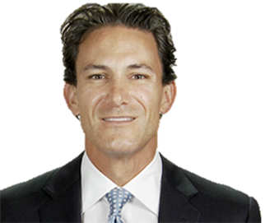

Dr Robert Marriott,MD, FACS, CEO
  Founded ASWC in 2007
  Chief Medical Officer of ASWC and Oversees 85 + physicians and 4 Medical Directors
  Completed Surgical residency at Saint Vincent’s Hospital in New York City in 2005

Slide 3

Other Regional Medical Directors
Frank Ciminello, MD, FACS
  Regional Medical Director, Northeast
  Board Certified by the American Board of Plastic Surgery
  Completed Surgical residency at Saint Luke’s Roosevelt Hospital in New York City in 2005, Plastic Surgery Fellowship at UC Davis Medical Center in 2007 and the Dr. Anthony Wolfe Craniofacial Surgery Fellowship at Miami Children’s Hospital in 2008 Lu’s Roosevelt Hospital in New York City in 2005, Plastic Surgery Fellowship at UC Davis Medical Center in 2007 and the Dr. Anthony Wolfe Craniofacial Surgery Fellowship at Miami Children’s Hospital in 2008urgical residency at Saint Luke’s Roosevelt Hospital in New York City in 2005, Plastic Surgery Fellowship at UC Davis Medical Center in 2007 the Dr. Anthony Wolfe Craniofacial Surgery Fellowship at Miami Children’s Hospital in 200
Daniel Brown, MD, FACS
  Regional Medical Director, Southwest
  Board Certified by the American Board of Plastic Surgery
  Completed his surgical residency at St. Vincent’s Hospital and Medical Center in New York City, Plastic Surgery Fellowship at NYU Medical Center and plastic surgery residency at UC San Diego Medical Center
Uri Gedalia, MD
  Regional Medical Director, South Central
  Board Certified by the American Board of Surgery
  Completed his surgical residency at St. Vincent’s Hospital and Medical Center in New York City and MIST Fellowship at UT Houston
  Committee Member of the American Board of Wound Care Management, Surgical Fellowship
John Griffin, MD
  Regional Medical Director, New England
  Board Certified by the American Board of Surgery, Board Certified by the American Board of Wound Management
  Completed his surgical residency at Morristown Memorial Hospital in Morristown, NJ, Surgical Fellowship

Slide 4

Highly-Trained Surgeons/
Extenders
Surgeons:
  110+ Highly Trained Surgeons, both full time and contracted
  Mid-level(Nurse Practitioners, Physician Assistants):
  19 Both part time and full time
  ***Wound Care Certification (Wound Care Certification for incoming providers through ABWM)

Slide 5

ASWC
Wound Care Priorities
Pressure Injury Priorities:
Cost: ASWC strives to reduce the cost of Pressure Injuries through reduced time to heal (documented outcomes superior to our peers) and attention to the cost of supplies. Following formularies and protocols already in place .
Liability: ASWC’s wound care protocols include full documentation and adherence to outcomes –based clinical guidelines, reducing risk of liability to a minimum. In addition, our educational services arm your staff with the tools and measures to evaluate risk factors and prevent PIs, ensuring that the risk is reduced throughout your organization.
Hospitalizations due to Pressure Injuries: Our proven protocols and conservative treatment goals focus on maintaining ambulation and reducing risk of deterioration requiring hospitalization.

Slide 6
ASWC
Wound Care Priorities
Non - Pressure Injury Priorities which affect 70% of our patients' vs 30% with PI
Approximately, 20% of the U.S. population has venous disease, leading to chronic, non-healing ulcers
Diabetes affects 8% of the U.S. population – an estimated 2.5 million people, leading to chronic wounds especially foot ulcers
Diabetics are 10 times more likely to require amputation at some point in their lives: ASWC strives to save the limb and avoid unnecessary amputations and hospitalizations

Slide 7

ASWC Services
Wounds: Pressure, Diabetic, Vascular, Traumatic, Post-Operative
Surgical Debridement (all levels)
Evaluation and Management of Non-Operative Surgical Conditions
Non-Invasive Vascular-Flow Study (with ABI)
Minor Surgical Abscess Drainage
Skin Lesion/Mass Biopsy
VAC and UNNA Boot Therapies
Suture/Staple/Drain Removal
Tracheostomy Change/Replacement
G-Tube and Super-Pubic Replacement
Dermatology
Telemedicine

Slide 8
Advantage Surgical Strengths
Wound Care Specialty with additional services, Advantage Surgical & Wound Care creates a partnership to manage PIs across the spectrum of care
ASWC surgeons become part of your center’s interdisciplinary care team
ASWC surgeons provide medical and educational rounds that benefit staffing
Convenience: bedside treatments (instead of transfer to A/C or ASC)
Cloud Based IT Infrastructure, Wound Expert, Vsee Telemedicine Program
Cost – PDPM regulation support, formulary and protocol
Lower acute-care readmission rates
Educational Support at the facility level to enhance nursing skills, knowledge and practice in the prevention and care of all types of wounds

Slide 9
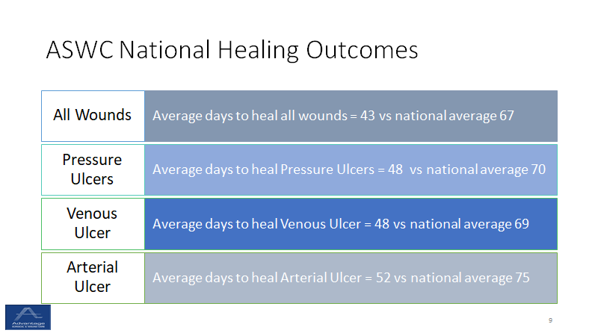

ASWC National Healing Outcomes
All Wounds
Average days to heal all wounds = 45 vs national average 68
Pressure Ulcers
Average days to heal Pressure Ulcers = 48 vs national average 70
Arterial Ulcer
Venous Ulcer
Average days to heal Venous Ulcer = 48 vs national average 68
Average days to heal Arterial Ulcer = 54 vs national average 75

Slide 10
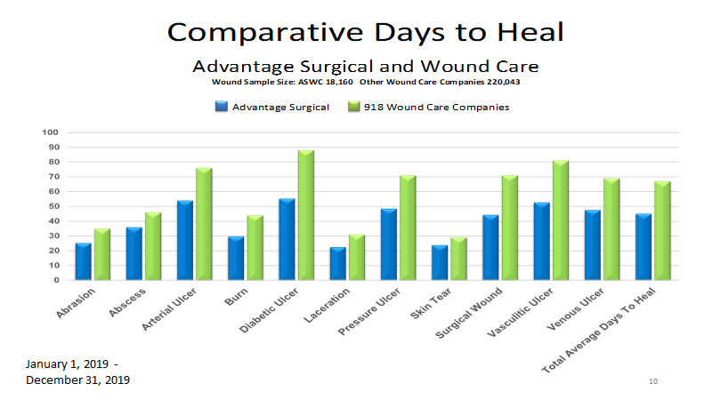

Slide 11
DETECT
TRAIN
EMPOWER
Our Providers work with assigned staff to identify at-risk patients; implementing interventions by use of Pressure Injury prevention care plans
Unavoidable Tag 686
Coordinate use of different modalities to achieve outcomes; Surgical debridement, Less frequency of change, to allow for healing, NPWT when appropriate
Collaborating with Medical Directors, PCPs, PT/OT, Social Services, Nursing for Team approach to care
ASWC offers In-service presentations, customized to all levels of nursing care including daily care givers, at the facility. Ongoing instruction during wound care rounds is continuously provided to nursing staff, family members and, most importantly, patients. Quarterly assessments to ensure the staff’s knowledge and understanding.

Slide 12


PDPM
Don’t get caught with your points down!
Diagnosis must be documented by a physician with supporting documentation before coding on the MDS
Timely and thorough skin assessment upon admission to identify all skin conditions present
Proper Classification of wounds based on etiology
Provider collaboration and oversight for implementing clinical protocols and individualized care plans will be instrumental in driving quality outcomes
Points | NTA Component | Points | NTA Component
2 | Bone/Joint/Muscle Infections/Necrosis- Except Aseptic Necrosis of Bone | 2 | Wound Infection Code
1 | Other Foot Skin Problems: Diabetic Foot Ulcer Code | 1 | Complications of Specified Implanted Device or Graft
1 | Active Dx: Multi-Drug Resistant Organism (MDRO) Code | 1 | Aseptic Necrosis of Bone
1 | Severe Skin Burn or Condition | 1 | Unhealed Pressure Ulcer Stage 4
1 | Other Foot Skin Problems: Diabetic Foot Ulcer Code | 1 | Special Treatments/Programs: Tracheostomy Care Post-admit Code
Stage 2 Pressure Ulcers
Stage 3 or 4 Pressure Ulcers
Venous/Arterial Ulcer
Infection of the Foot
Diabetic Foot Ulcer
Other open Lesion(s) on the foot
Open Lesions (other than ulcers, rashes, and cuts)
Surgical Wound
Burns
Example Case:
Patient, Betty Brown, recently admitted from the hospital to SNF with a wound the hospital documented as Stage 2 Pressure Injury on the L Buttock. The ASWC Provider in the building did a thorough assessment and found 2 Stage 2 Pressure Injuries on the L Buttock, which then resulted in the proper coding and reimbursement.

Slide 13
ASWC Partnership
Collaboration between staff and rounding Surgeon
∙ Providers available for meetings with Families, PCPs, other Surgical Consultants
∙ Projects on Wound Care Prevention and PIs
∙ Outcome Reports and Provider attendance at QAPI Meetings
∙ Creating clear transparency
Dedicated ASWC staff
∙ Highly Trained Surgeons/Extenders
offering continuity of care
∙ Business Development Manager
∙ EMR Specialist for note retrieval
∙ Continued Educational Support

Slide 14
Your ASWC Team
Dr Robert Marriott, CEO
Robert@advantagewoundcare.org
Tara Frazier, Chief Clinical Officer ASWC
tara@advantagewoundcare.org
Aaron Anderson, VP Marketing – West Region
aaron@advantagewoundcare.org
Robin Pasquarosa, Business Development Manager – West Region
robin@advantagewoundcare.org

